Slide 1
IMS Network Batch-3
GROUP- 4
Kuldeep
Sushant
Pavani
Vanaja
Vaibhav
Notes:
Abhijeet More

Slide 2
Hardware Fundamentals
Notes:
Abhijeet More

Slide 3
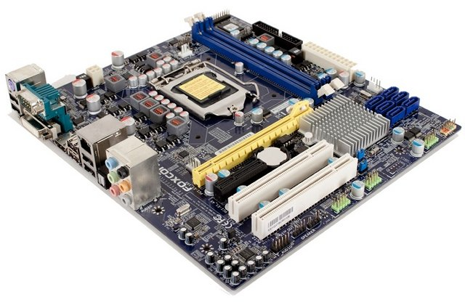
Motherboard
DIMM SLOT
CPU SOCKET
24 PIN ATX CONNECTOR
SATA CONNECTORS
CMOS BATTERY
BACK PANEL
(PERIPHERAL CONNECTORS)
PCI SLOT
FRONT PANEL CONNECTOR PINS
PCI XPRESS SLOT

Slide 4
Motherboard
Major components of motherboard
CPU Socket
Front panel USB connectors
Front panel
RAM slots
PCI express slot
SATA connectors
Back panel
North Bridge
ATX connector
PCI Slots
South Bridge

Slide 5
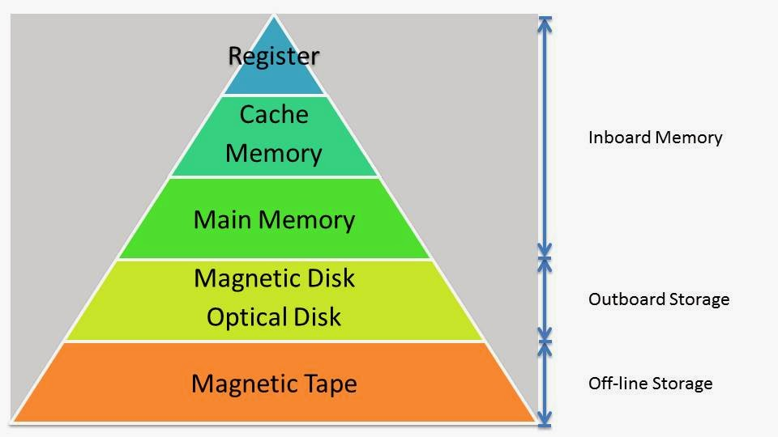
Memory
Memory Hierarchy

Slide 6
Memory
Memory Types
MEMORY
SEQUENTIAL ACCESS MEMORY
RANDOM ACCESS MEMORY
READ ONLY MEMORY
READ/WRITE MEMORY
PROM
STATIC RAM
EPROM
DYNAMIC RAM
EEPROM

Slide 7
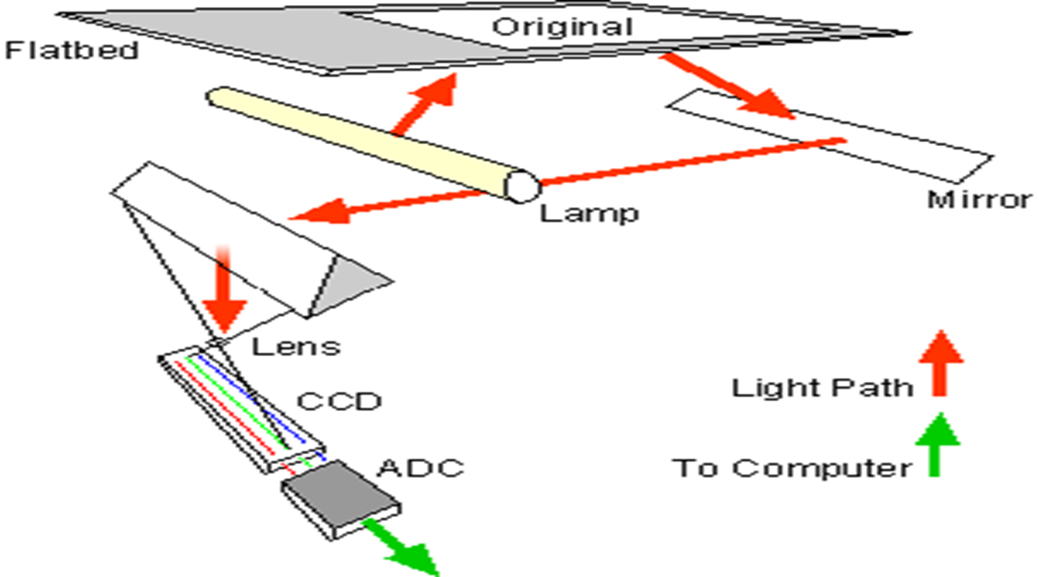
Scanner
INPUT DEVICE
Flatbed Scanner
Components
Flatbed
Mirror
Lamp
Lens
CCD
ADC

Slide 8
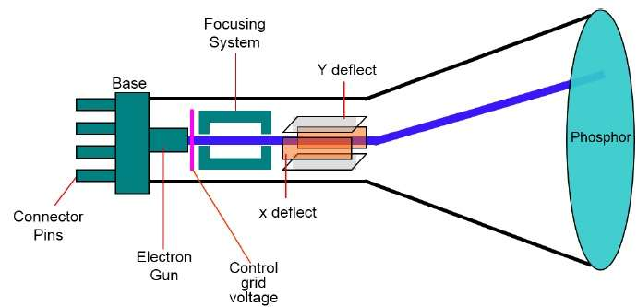
CRT
OUTPUT DEVICE
Cathode Ray Tube
Components
Electrongun
Controlgrid
Focusing system
deflection plates

Slide 9
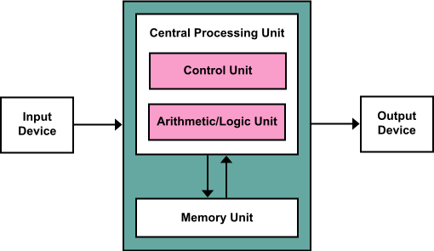
CPU
CPU
Components
Control unit
ALU
Memory unit

Slide 10
Windows & Linux Fundamentals
Notes:
Abhijeet More

Slide 11
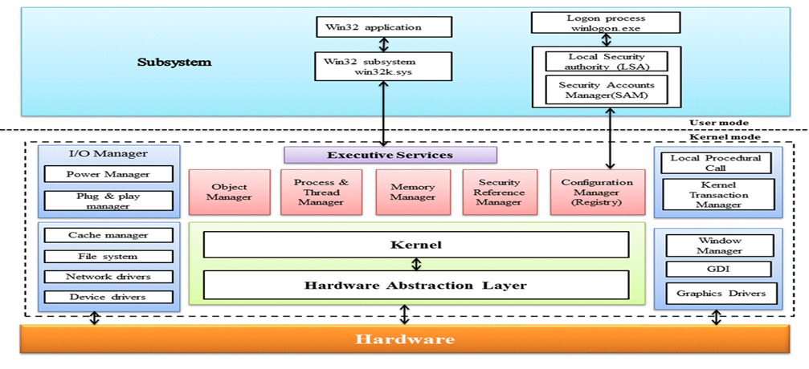
Window Kernel Architecture

Slide 12
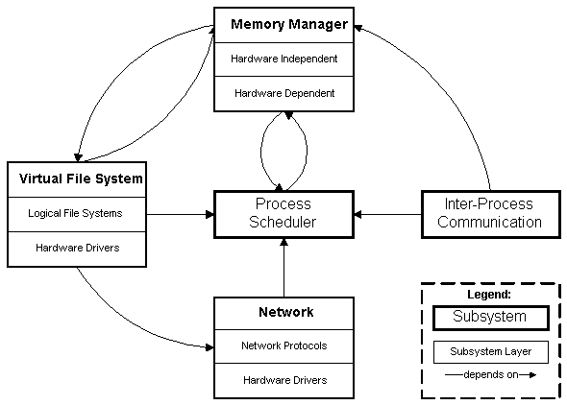
Linux Kernel Subsystem

Slide 13
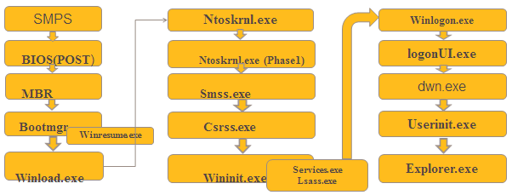
Window Booting Process
Flow of booting process.

Slide 14
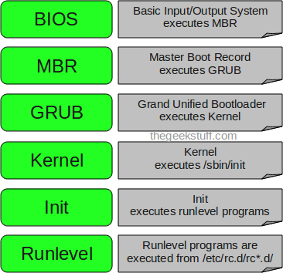
Linux Booting Process

Slide 15
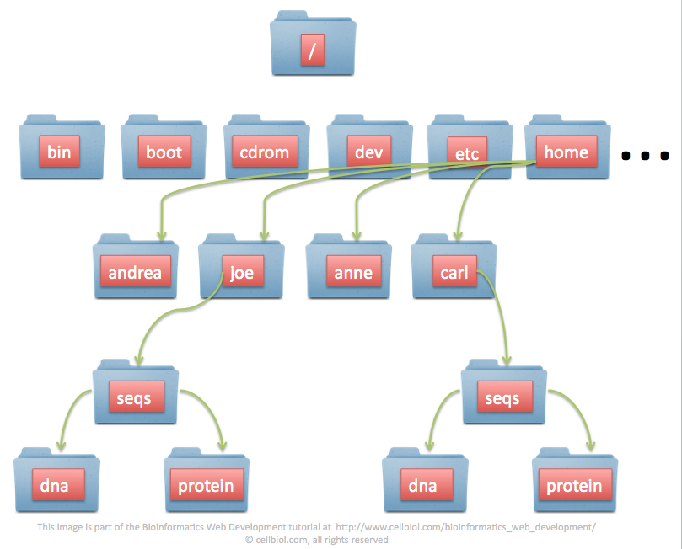
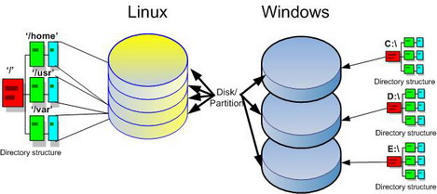
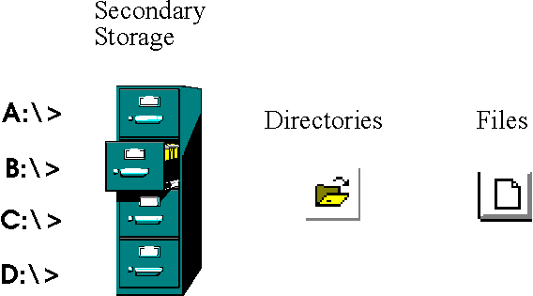
File System
A filesystem is the methods and data structures that an operating system uses to keep track of files on a disk or partition; that is, the way the files are organized on the disk..

Slide 16
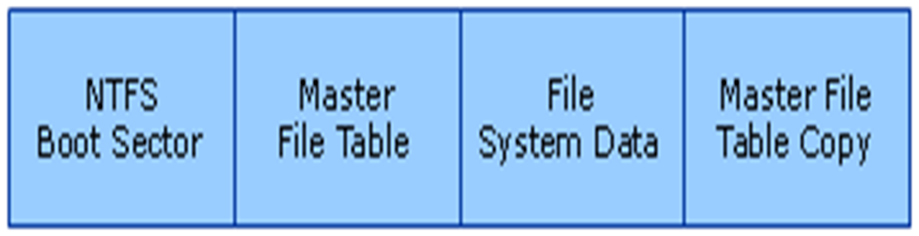
Windows File System
Types of File System :
FAT
BOOT SECTOR
RESERVEDSECTOR
FAT 1
FAT2
ROOT
FOLDER
OTHER FOLDER
NTFS

Slide 17
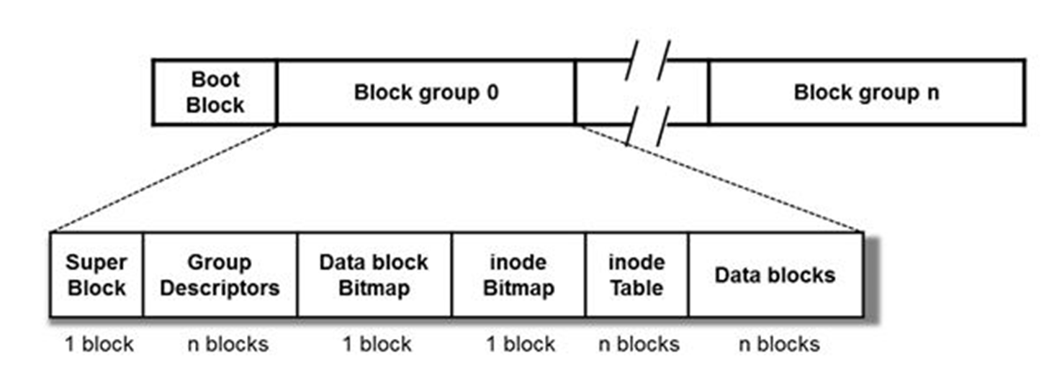
LINUX File System
Types of FS
Minix Fs
EXT
EXT2
EXT3(Journaling )
EXT4
Journal
Ordered
Write Back

Slide 18

Memory Management
Terms and Concepts
Logical and physical Address
Memory Management Unit
Paging
Address Translation scheme
Memory Protection
Virtual Memory

Slide 19
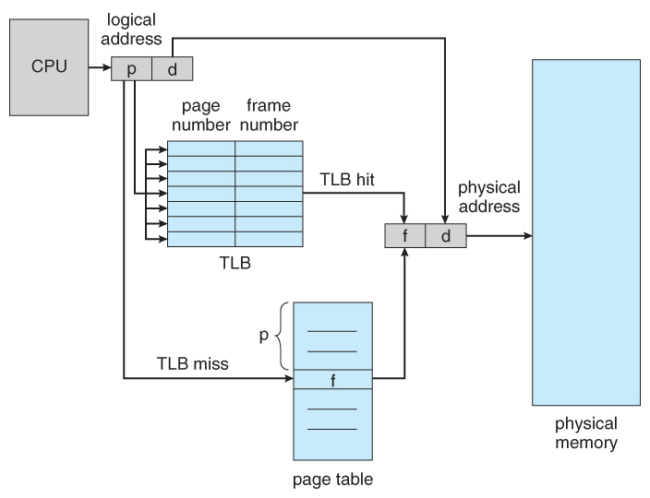
Memory Management
Address Translation

Slide 20
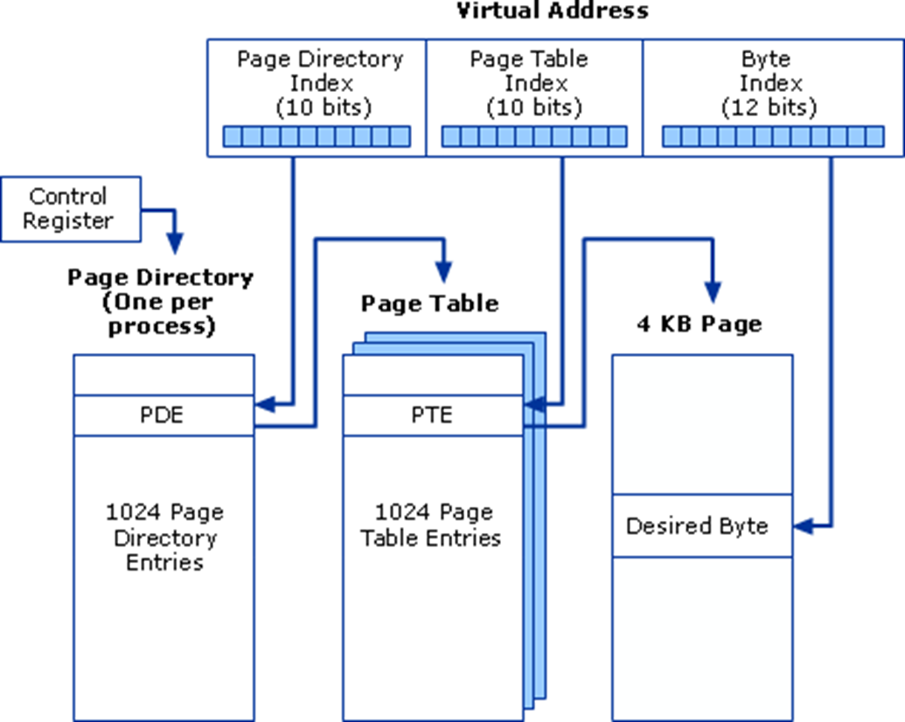
Memory Management
Page address extensions

Slide 21
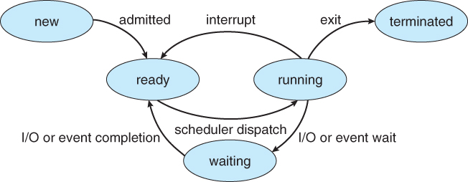
Windows and Linux
Process Management for Windows
Process Management for Linux
Process Scheduling Types :
Normal Process
Interactive Process
Batch/Automatic Process
Real Time Process
Zombie Process
Parent Process & Child Process
Orphan Process

Slide 22
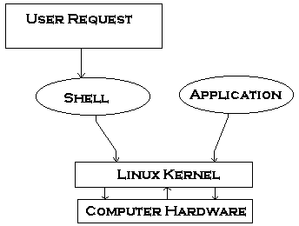

Linux
Shell
Shell is a user program provided for user interaction.
The shell accepts human readable commands and translates them into something the kernel can read and process.
Features of Shell
Background processing
Command aliasing
Command history
Piping

Slide 23
Shell
Shell Commands
Filesystem browsing : pwd , cd and ls
File & Directory management : ls , ls –l , Single dot (.) , Double dot (..) , vi editor , cat , wc , cp source_file destination_file , mv old_file new_file , rm filename .
Process management : ps (process status) , ps –f , kill 6738 , top .
User management : useradd , usermod , and userdel

Slide 24
Application Fundamentals
Notes:
Abhijeet More

Slide 25
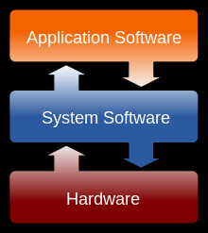
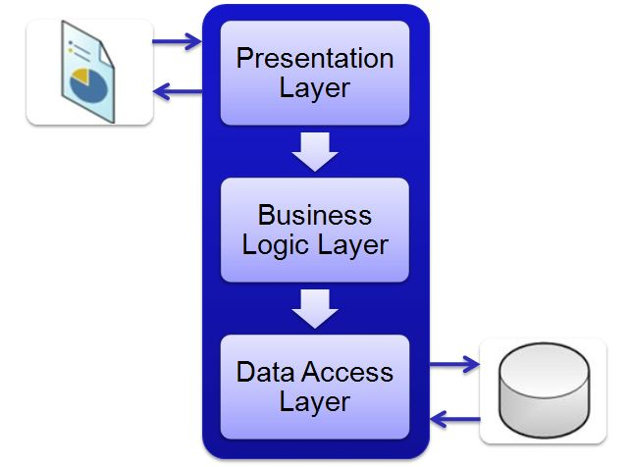
Applications
Components

Slide 26
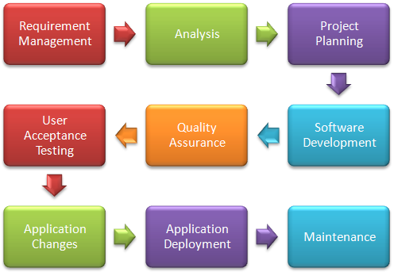
Life cycle of application

Slide 27
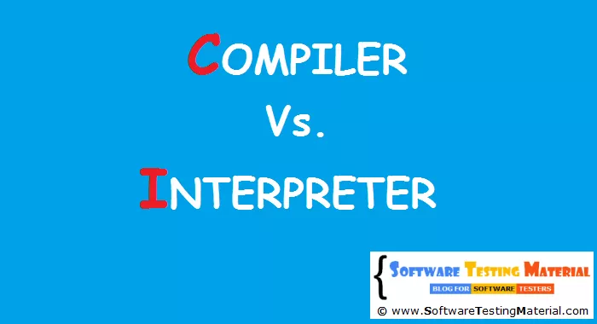
Types of applications
Compiled application.
Interpreted application.

Slide 28

API

Slide 29
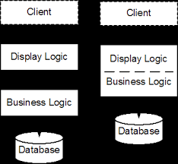
Application architecture
Thick client application.
Thin client application.
Rich internet application.
What is tier?
2 tier application.
3 tier application.

Slide 30
Network Fundamentals
Notes:
Abhijeet More

Slide 31
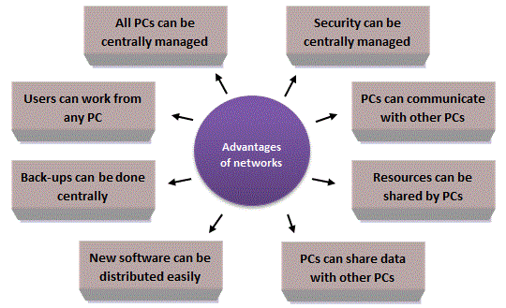

Network
What is network?
Network is the practice of interfacing two or more computing devices with each other for the purpose of sharing data.

Slide 32
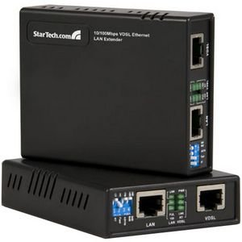
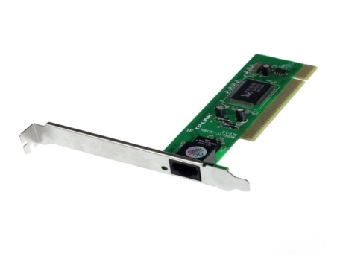
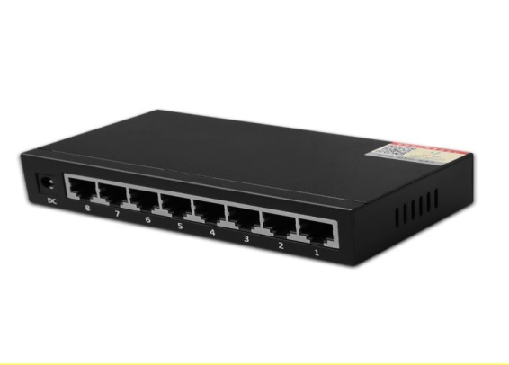
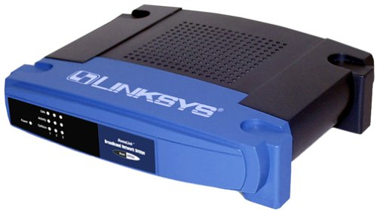
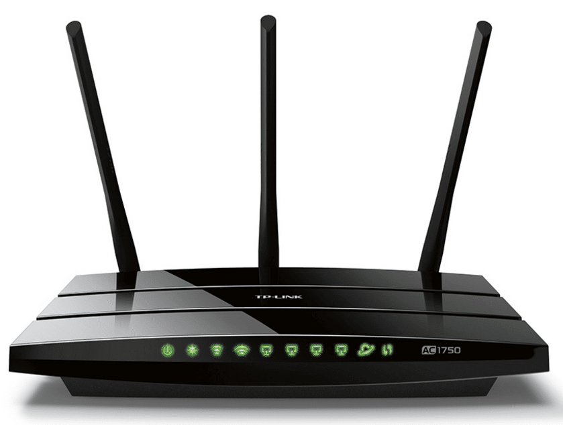
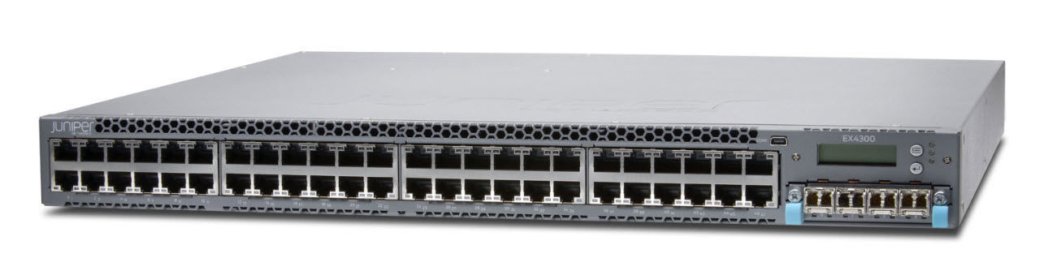
Network Devices
Several network devices are
NIC ( Network Interface Card )
Network HUB
Repeater
Bridge
Network Devices
Switch
Router

Slide 33
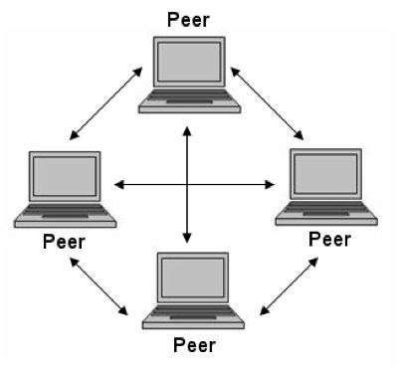
Network Architecture
Characteristics of Network Architecture
Fault Tolerance
Scalability
Quality of Service
Security

Slide 34
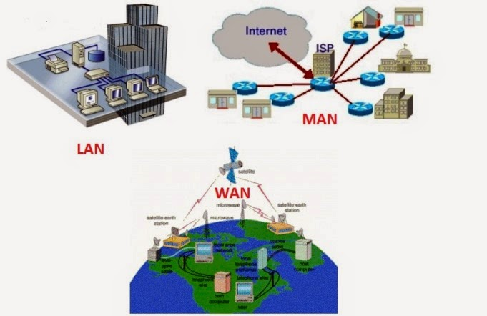
Network Types
LAN
WAN
MAN
WLAN

Slide 35
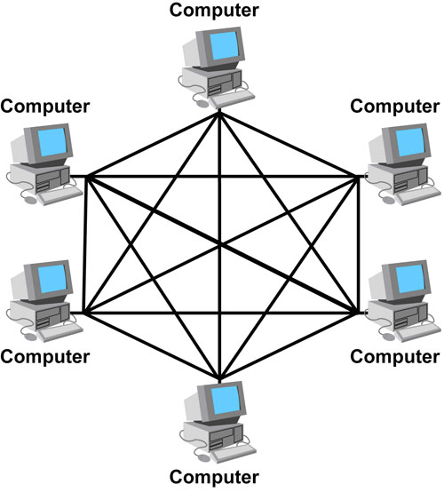
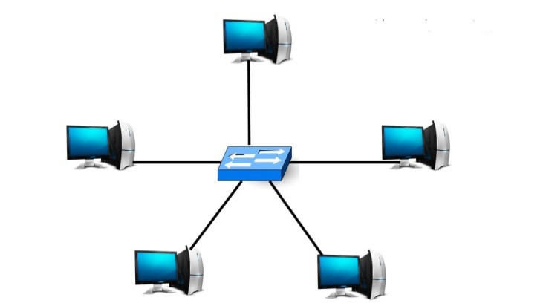
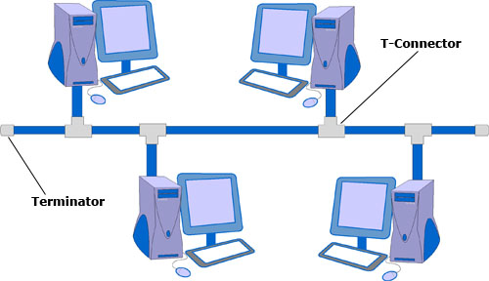
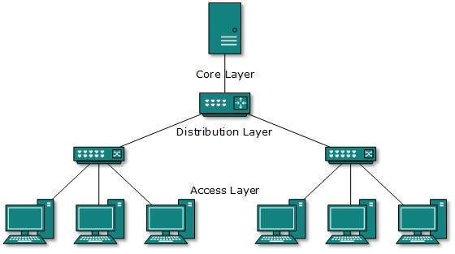
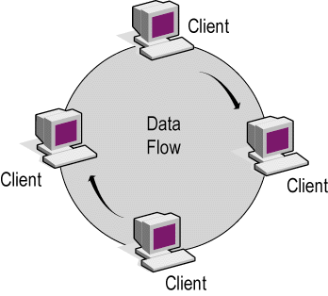
Network Topology
Different types of Topology are:

Slide 36
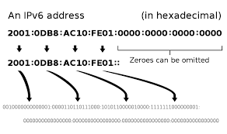
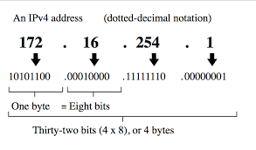


Internet Protocols
IPv4
IPv6

Slide 37
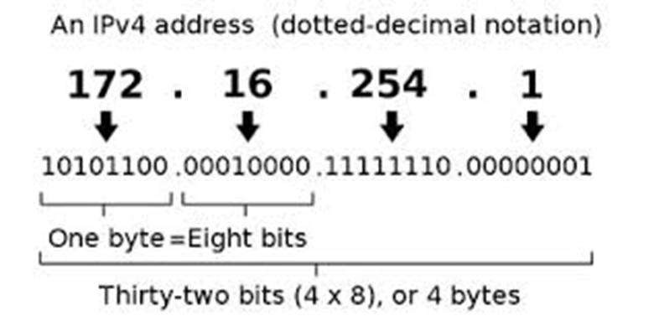
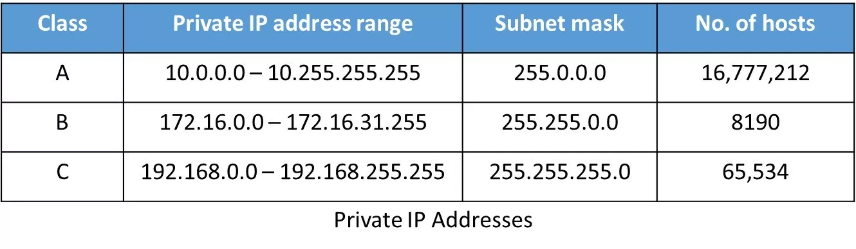
IP Addressing Structure
IP Address(internet protocol)
IP is a unique address that computing devices to
identify itself and communicate with other devices
in the IP network.
Types of address
1.Public IP
2.Private IP

Slide 38
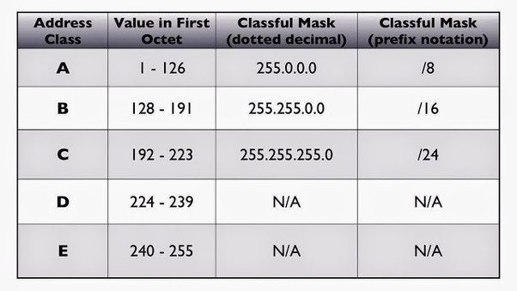
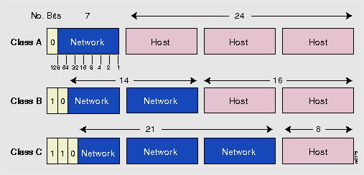
IP Addressing Structure
Classifications of IP address
The Internet community originally defined five address classes to accommodate networks of varying sizes.
According to their classes.

Slide 39
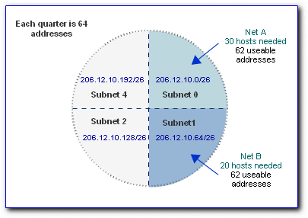
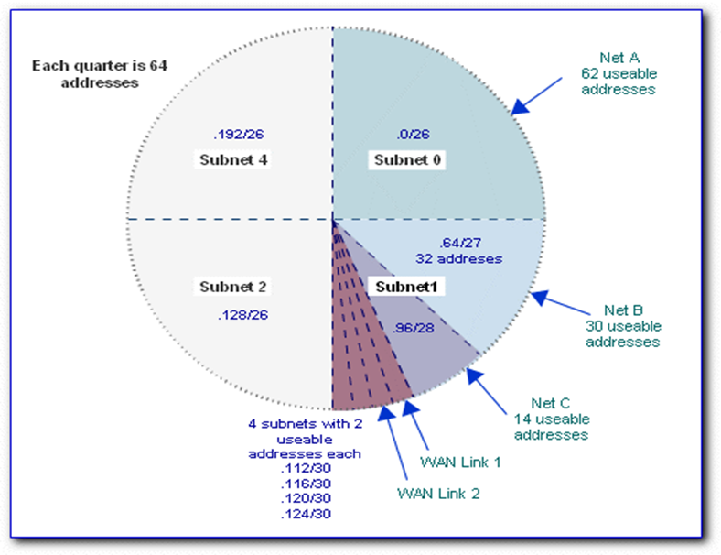
Subnetting
The process of subnetting involves dividing a network into smaller networks called subnets or sub networks.
TYPES:- FLSM VLSM

Slide 40
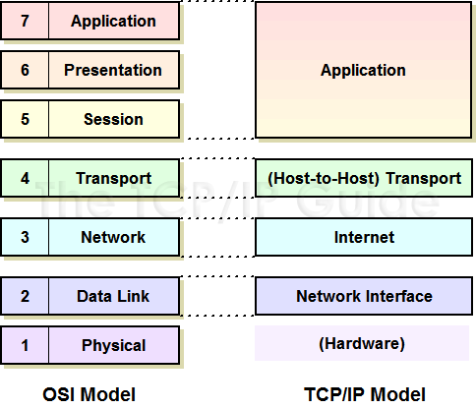
TCP/IP Suite
Difference between OSI Model and TCP/IP Model

Slide 41
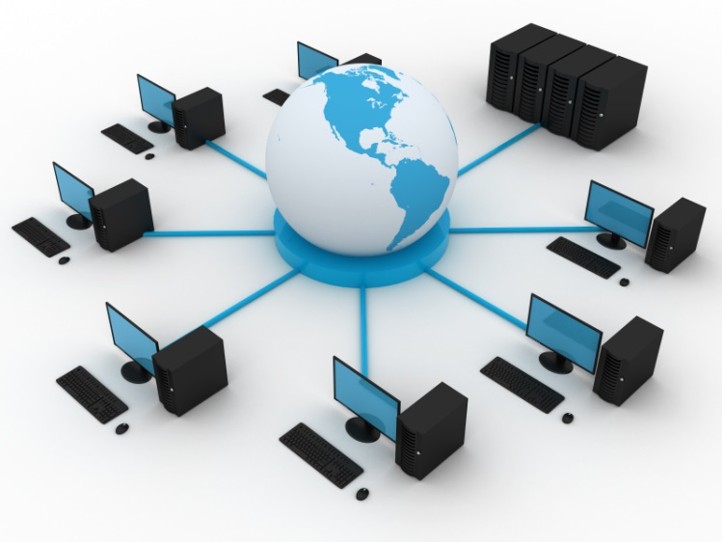
Network Services

Slide 42
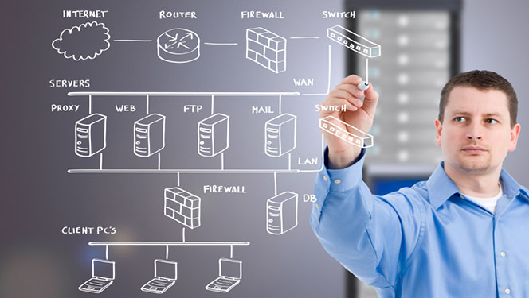
Network Services
WHY NETWORK SERVICES ?
A Network Service is function provided by the network infrastructure that offers value to the business process.
A Network Service is an application that provides data storage, manipulation, presentation, communication or other capability.

Slide 43
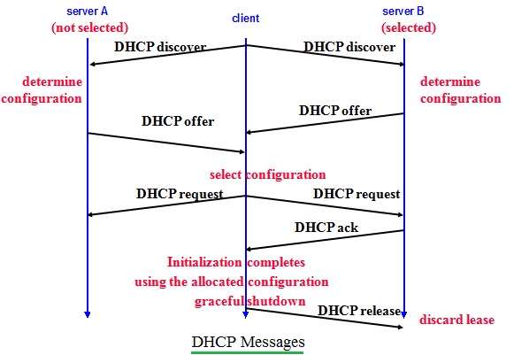
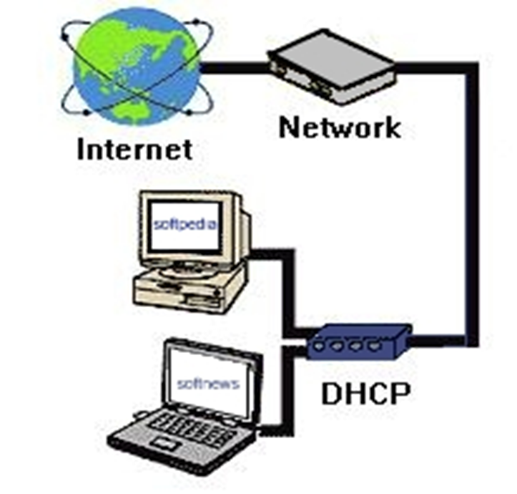
Network Services
Dynamic Host Configuration Protocol
DHCP : It is a method for assigning Internet Protocol (IP) addresses in network.

Slide 44

Network Services
DNS
DNS : DNS is a hierarchical decentralized naming system for computers, services, or other resources.
DNS Hierarchy : It is process to find how a Domain name entered by user.
DNS Server : It stores the IP address of the host where its name resides in the tree.

Slide 45

Network Services
Types Of Name Resolution
Iterative Name Resolution : It allows the DNS server to return the best answer it can give based on its cache or zone data.
Recursive Name Resolution : Recursive name queries are generally made by a DNS client to a DNS server

Slide 46

Network Services
Directory Services
Directory services : A directory service is a customizable information store that functions as a single point from which users can locate resources and services distributed throughout the network.
Types of Directory Services :
LDAP : Stores user information in an LDAP-based directory server.
Key File : stored in a key file for authorization and authentication
Digest File : Stores information based on encrypted username and password.
LDAP

Slide 47

Network Services
Proxy Services
Proxy server is a server that acts as an intermediary for requests from clients seeking resources from other servers.
Types of Proxies
Forward proxies
Reverse proxies

Slide 48

Network Services
Mail Services
A mail server is a computer system that sends and receives email.
Protocols used :
SMTP : Sending mail
IMAP and POP3 : Receiving mail

Slide 49
Network Services
Conclusion
Less Operating Costs of Entire IT Network
Network Maintenance
Enhanced Network Security
Enables a High Level of Network Availability
Improved Quality of Service (QoS)
Maximized Performance and Increased Productivity

Slide 50
Database Fundamentals
Notes:
Abhijeet More

Slide 51

History of database

Slide 52
DBMS
File based approach Disadvantages:
Integrity problems.
Concurrent access.
Data isolation.
Unanticipated queries.
Data redundancy.
DBMS advantages:
Concurrent use.
Structure and description.
Transactions.
Data persistence.
views.
Recovery services.

Slide 53

Acid properties:

Slide 54
Terminologies
Entity.
Attribute.
Tupple.
Domain.
Degree.
Cordiality

Slide 55
RDBMS
RDBMS stands for Relational Database Management Systems.
Constraints:
Null constraint.
Not null constraint.
Unique constraint.
Default constraint.
Primary key constraint.
Foreign key constraint

Slide 56
Ef codd rules:
Structural rule: rule 1(information representation).
rule 6(view updating).
Integrity rule: rule 3(systematic rules of null values).
rule 10(integrity independence).
Data manipulation rule: rule 2(guaranteed access).
rule 4(dynamic online catalog).
rule 5(comprehensive data sub language).
rule 7(high level insert, update, delete)
Data independence rule: rule 8(physical data independence).
rule 9(logical data independence).
rule 11(distribution independence).
Foundational rule: rule 12(non subversion rule).
rule 0(foundational rule).

Slide 57
Normalization
Database Normalization is a technique of organizing the data in the database.
Normalization is used for mainly two purpose:
Eliminating redundant(useless) data.
Ensuring data dependencies make sense
1 NF
item | Color | Price | tax
samsung | red, blue | 5000 | 0.25
motorola | Black, white | 4000 | 0.25
item | Color | Price | tax
samsung | Red | 5000 | 0.25
samsung | Blue | 5000 | 0.25
motorola | Black | 4000 | 0.25
motorola | white | 4000 | 0.25

Slide 58
2 NF
item | Color
samsung | Red
samsung | Blue
motorola | Black
motorola | white
item | Price | tax
samsung | 5000 | 0.25
motorola | 4000 | 0.25
3 NF
item | Color
samsung | Red
samsung | Blue
motorola | Black
motorola | white
item | Price
samsung | 5000
motorola | 4000
Price | tax
5000 | 0.25
4000 | 0.25

Slide 59

Structured query language
SQL is a standard computer language for relational database management and
data manipulation.

Slide 60

General RDBMS architecture
Application layer.
Logical layer.
Physical layer.

Slide 61
Storage Fundamentals
Notes:
Abhijeet More

Slide 62

Storage
NL
Storage Types
STORAGE
Fiber channel:-
NL
NL
HOST
NL
NL
STORAGE
NL
Arbitrated Loop

Slide 63

Storage
Storage Types
DAS :- Direct-attached storage (DAS) is digital storage directly attached to the computer accessing it, as opposed to storage accessed over a computer network.
NAS:- A Network Attached Storage (NAS) device is a storage device connected to a network that allows storage and retrieval of data from a centralized location

Slide 64


Storage

Slide 65



Storage
RAID( Redundant array of independent disks )

Slide 66

Storage

Slide 67
Thank you

